Slide 1
Internet of Things with Arduino

Slide 2
Introduction to IoT
IoT is simply the network (internet) of physical objects.
IoT refers to the connection of objects to each other and to humans through the internet
The physical things are added with computational intelligence and an internet connection.
Example a refrigerator ( IoT refrigerator ).
IoT does not change the simplicity of a thing, instead it enhance its simplicity and basically simplifies the complexity.

Slide 3
Introduction to IoT Cont ....
IoT devices are not computers because the main function of a computer is to compute ( to run instructions) but IoT devices do not compute also Computers are general-purpose while IoT devices are specific-purpose.
Embedded systems are related to IoT devices and generally IoT devices are typically embedded systems.
Embedded systems are computer-based systems, but they do not appear to be computers.
Complexity is hidden from the user.

Slide 4
Embedded means something is attached to another thing.
A system is an arrangement in which all its unit assemble work together according to a set of rules.
Embedded system is a microcontroller of microprocessor based system which is designed to perform a specific task.
Example a fire alarm that sense only smoke and sound an alarm, an automatic light control gives light when it is dark, this only sense darkness, e.t.c
An embedded system has 3 components namely Hardware, Software and RTOS ( Real Time Operating System ) that supervise the application software.
A small scale embedded system may not have RTOS.

Slide 5
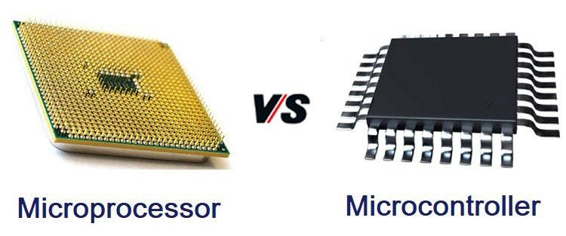
Introduction to IoT Cont ...
An embedded system contains a microcontroller or microprocessor, a memory and other components to enable its operations.
Microprocessor consists of only a CPU while a Microcontroller consists of CPU, Memory and I/0 all integrated into a single chip

Slide 6
Applications of IoT
The applications of IoT technologies are multiple, because it is adjustable to almost any technology that is capable of providing relevant information about its own operation, about the performance of an activity and even about the environmental conditions that we need to monitor and control at a distance.
Some of the applications of IoT includes Wearables, Health, Traffic monitoring, Agriculture, Hospitality, Smart grid and energy saving, Water supply, Maintenance management among others.

Slide 7
Challenges facing IoT
Security
Regulation
Compatibility
Bandwidth
Customer expectations(under promise and over deliver)

Slide 8
Future of IoT
The future of IoT has the potential to be limitless.
Advances to the industrial internet will be accelerated through increased network agility, integrated AI, and the capacity to deploy, automate, orchestrate and secure diverse use case at hyperscale.

Slide 9
Interaction of Arduino with IoT devices
Microcontrollers also have peripherals that allow them to interact with the physical world through sensors (e.g temp sensor) and actuators (e.g motors)
IoT devices must be able to connect to the internet.
List of modules that help Arduino interact with IoT devices are such as GSM/GPRS shield, ESP8266 Wi-Fi module, bluetooth module among others.

Slide 10


